Slide 1

Hypothesis Formulation

Slide 2
Learning Objectives
By the end of this session, you will be able to:
Basics of Hypothesis Testing
Steps of Hypothesis Testing
Formulate H₀ and H₁
Types of Error
Significance Level
Types of Statistical Tests

Slide 3
What is a Hypothesis and Hypothesis Testing?
An assumption or educated guess about a population parameter.
Tested using sample data.
Hypothesis testing is like a detective game where you :
1. start with an assumption (a hypothesis);
2. then collect evidence (data) to decide whether
3. your assumption is likely to be true or not.
It’s a way of making decisions or inferences about a population based on a sample of data.

Slide 4
Steps in Hypothesis Testing
1. Formulate H₀ and H₁
1
2. Choose α
2
3. Select Test
3
4. Calculate Test Statistic
4
5. Make Decision
5

Slide 5
Types of Hypotheses
✅ Null Hypothesis (H₀): This is the hypothesis that there is no effect or no difference. It’s the status quo or the assumption we want to test against.
✅ Alternative Hypothesis (H₁): Opposite of null hypothesis.
When the null hypothesis is rejected the alternate hypothesis is accepted and vice versa.

Slide 6
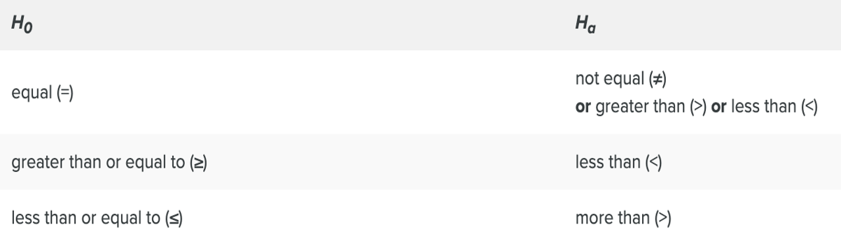
Null and Alternate Hypothesis
Null Hypothesis:
Hypothesis of no difference (Status Quo)
Alternate hypothesis:
Mutually exclusive statement of Null hypothesis

Slide 7
Examples
Problem: Is the new drug better?
✅ H₀: New drug = Old drug
✅ H₁: New drug ≠ Old drug
Company claims average salary = ₹50,000/month.
✅ H₀: μ = 50,000
✅ H₁: μ ≠ 50,000

Slide 8
Examples
Construct the null and alternative hypothesis for the following situation:
Your mobile bill per month is INR 600 per month with a standard deviation of INR 50.
This month you received a bill of INR 750.
You feel that the bill was high and you want to investigate if there is any reason for concern.

Slide 9
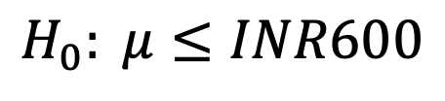
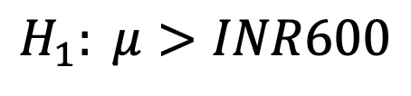
Examples
Construct the null and alternative hypothesis for the following situation:
Your mobile bill per month is INR 600 per month with a standard deviation of INR 50.
This month you received a bill of INR 750.
You feel that the bill was higher than the normal average bill and you want to investigate if there is any reason for concern.

Slide 10
Steps in Hypothesis Testing
1. Formulate H₀ and H₁
1
2. Choose α
2
3. Select Test
3
4. Calculate Test Statistic
4
5. Make Decision
5

Slide 11
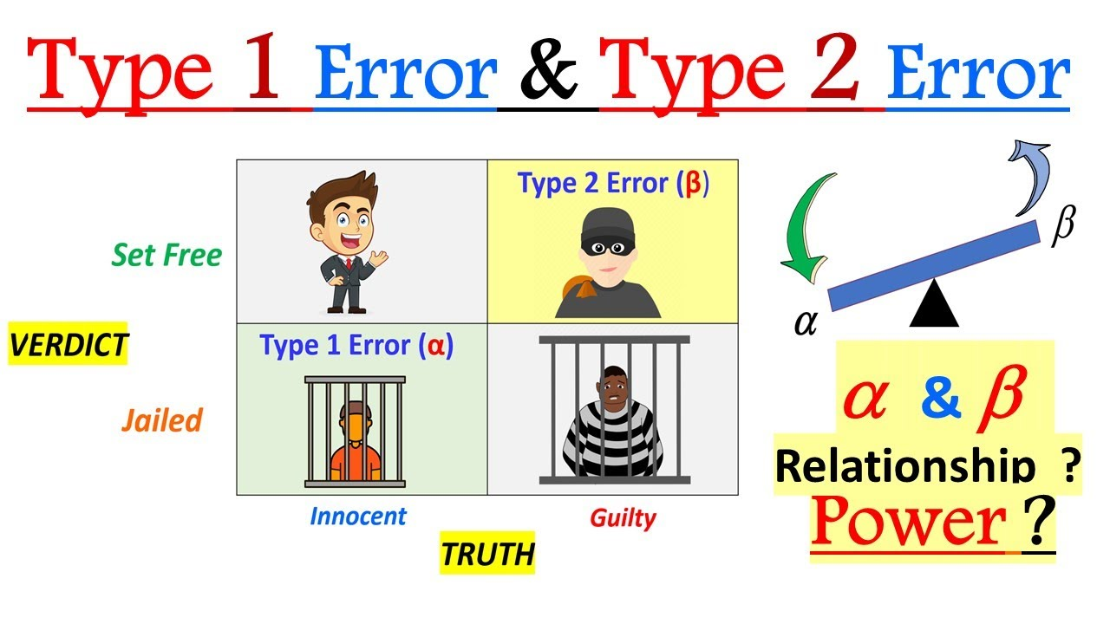
Significance level – Type 1 and Type 2 Error

Slide 12
Significance level – Type 1 and Type 2 Error
Level of significance (alpha) is the probability of rejecting the null hypothesis when it is true.
α =0.01 or 1%
α =0.05 or 5%
α =0.10 or 10%

Slide 13
Steps in Hypothesis Testing
1. Formulate H₀ and H₁
1
2. Choose α
2
3. Select Test
3
4. Calculate Test Statistic
4
5. Make Decision
5

Slide 14
Types of Tests
A one-tail test tests for the possibility of the relationship in one direction, either greater than or less than a certain value. Directional (> or <)
A two-tail test tests for the possibility of the relationship in both directions, whether it’s significantly greater or less than a certain value. Non-directional (≠)
Two tail | Left tail | Right tail
H0: Mean=50 Ha: Mean≠50 | H0: Mean ≥ 50 Ha: Mean < 50 | H0: Mean ≤ 50 Ha: Mean >50

Slide 15
Steps in Hypothesis Testing
1. Formulate H₀ and H₁
1
2. Choose α
2
3. Select Test
3
4. Calculate Test Statistic
4
5. Make Decision
5

Slide 16
Test Statistic
A test statistic is a standardized value derived from sample data during a hypothesis test.
It helps determine whether to reject the null hypothesis.
Different tests (t-test, chi-square, etc.) have different formulas for calculating their respective test statistics.
Test statistics$= \frac{Sample statistic−Population Parameter}{Standard Error}$

Slide 17
Test Statistic
We want to test that the population mean is less than 10
We want to test that the population mean is greater than 10
We want to test that the population mean is different than 10
Two tail | Left tail | Right tail
H0: Mean=10 Ha: Mean≠10 | H0: Mean ≥ 10 Ha: Mean < 10 | H0: Mean ≤ 10 Ha: Mean >10
Commonly used Critical z values
Significance Level (⍺) | Two-Tailed Test | One-Tailed Test (Left) | One-Tailed Test (Right)
0.01 | ±2.58 | -2.326 | +2.326
0.05 | ±1.96 | -1.645 | +1.645
0.10 | ±1.645 | -1.282 | +1.282

Slide 18
MCQ
1. What is H₀ usually about?
A) No change
B) New discovery
C) 5% significance
2. Which error occurs when H₀ is wrongly rejected?
A) Type I
B) Type II
C) Type III

Slide 19
MCQ
1. What is H₀ usually about?
A) No change ✅
B) New discovery
C) 5% significance
2. Which error occurs when H₀ is wrongly rejected?
A) Type I ✅
B) Type II
C) Type III

Slide 20
Steps in Hypothesis Testing
1. Formulate H₀ and H₁
1
2. Choose α
2
3. Select Test
3
4. Calculate Test Statistic
4
5. Make Decision
5

Slide 21
Session Summary
In this session, we have discussed about:
Basics of Hypothesis Testing
Steps of Hypothesis Testing
Formulate H₀ and H₁
Types of Error
Significance Level
Types of Statistical Tests

Slide 22
Reference links
Introduction to Hypothesis Testing
Frequently asked hypothesis testing interview questions and answers – part 1
Frequently asked hypothesis testing interview questions and answers – part 2
Frequently asked hypothesis testing interview questions and answers – part 3

Slide 23

THANK YOU
For any Query:
Website- www.onlinecu.in
Helpline no.: 1800 121 388 800

